Slide 1

Expanding Reporting Capabilities with Jupyter Notebook, Pandas, and Seaborn
Anthony Melson & Jonas Malave Campos

Slide 2
Agenda
Why does this approach matter?
What are Jupyter Notebook, Pandas, and Seaborn?
Connection to data sources, central features, and extensions
Completing necessary Set Up
Demo/Walkthrough with Pandas and Seaborn
More from Jupyter Environment

Slide 3
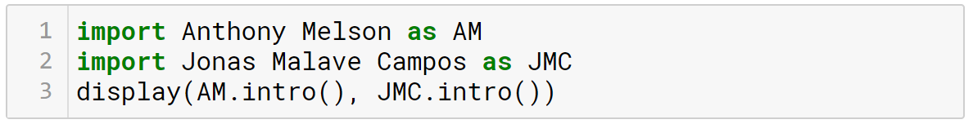
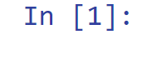


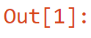
Introduction Anthony & Jonas
Anthony Melson
Jonas Malave Campos
Data Scientist
Senior Specialist in Advanced Analytics at Caleres
Data Analyst/Business Analyst
Consultant at Sense Corp

Slide 4




What’s the problem?
We need to report on our new digital marketing, but we don’t know our KPIS yet.
Requires preprocessing beyond SQL capabilities.
Let’s start iterating on this new report and see where it takes us.
Requires machine learning.
Notes:
Let’s say Karen, a stakeholder in the marketing department asks you to do an ad hoc/small report [insert type of problem].
You as Data Analyst or Scientist know that the report might be too complex because the data is not in good shape and you don’t have as much as flexibility you would like to create the ad hoc report. However, You know you can create this report using Pandas and Seaborn with Python. You also know that Jupyter Notebook have the ability to be shared properly with extra functionality.

Slide 5

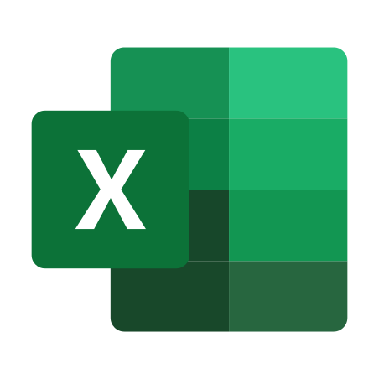


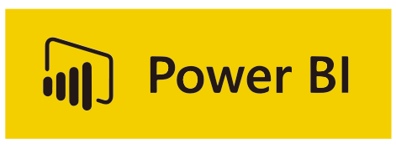
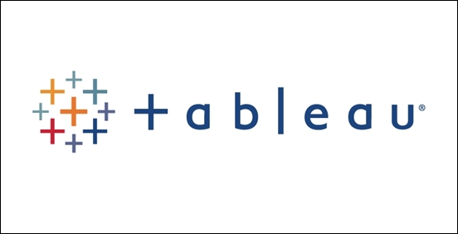
Solution
What are my options?
Notes:
Power BI and Table takes time and processes
Excel looks in tabular form doesnt handle more than 1 million rows
Doing loops

Slide 6




Why Does This Matter?
Iterative Reporting
Faster Than BI Tools
Flexibility and Power for All Tasks
Leveraging
Notebook Environment Capabilities
Notes:
Iterative reporting (Fast changes, preprocessing the data)
Limitations of BI tools (Time)
Ability to play around in one place (defined functions, classes, machine learning)
Add on to what JNB is used for
Leveraging the capabilities to increase use efficiency.
Cover all audience
Let’s say Karen, a stakeholder in the marketing department asks you to do an ad hoc/small report [insert type of problem].
You as Data Analyst or Scientist know that the report might be too complex because the data is not in good shape and you don’t have as much as flexibility you would like to create the ad hoc report. However, You know you can create this report using Pandas and Seaborn with Python. You also know that Jupyter Notebook have the ability to be shared properly with extra functionality.
Bring Anthony’s marketing example as well.

Slide 7

Let’s Understand Jupyter Notebook and Its Features

Slide 8




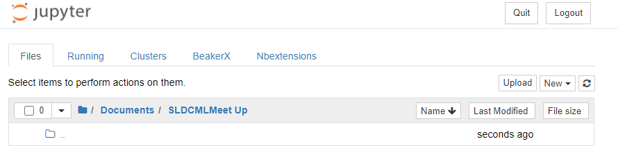
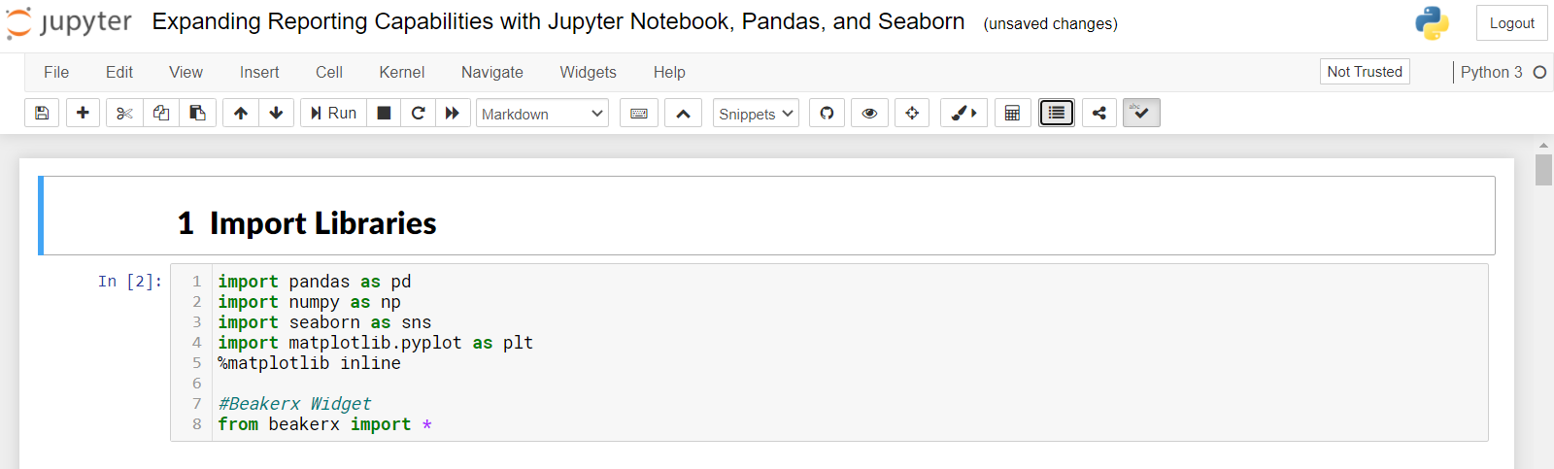
Jupyter Notebook
Open Source
Programming Languages
Notebook
Data Science & More
Notes:
What is Jupyter Notebook?
Open-source software and server-client application allowing editing and running notebook documents (code, equations, visualizations, and narrative text)
What is it for (common uses cases)/ How Python fits?
Data cleaning and transformation.
Numerical Simulation
Statistical Modeling
Data Visualization
Machine Learning
Anaconda (Another option to access Jupyter Notebook (recommended))
Open-source environment that centralizes the access to multiple tools and languages tailored for Data Scientits.
Talk every piece slowly and emphasize that they will see more about JPNB on the demo.

Slide 9


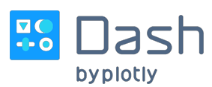

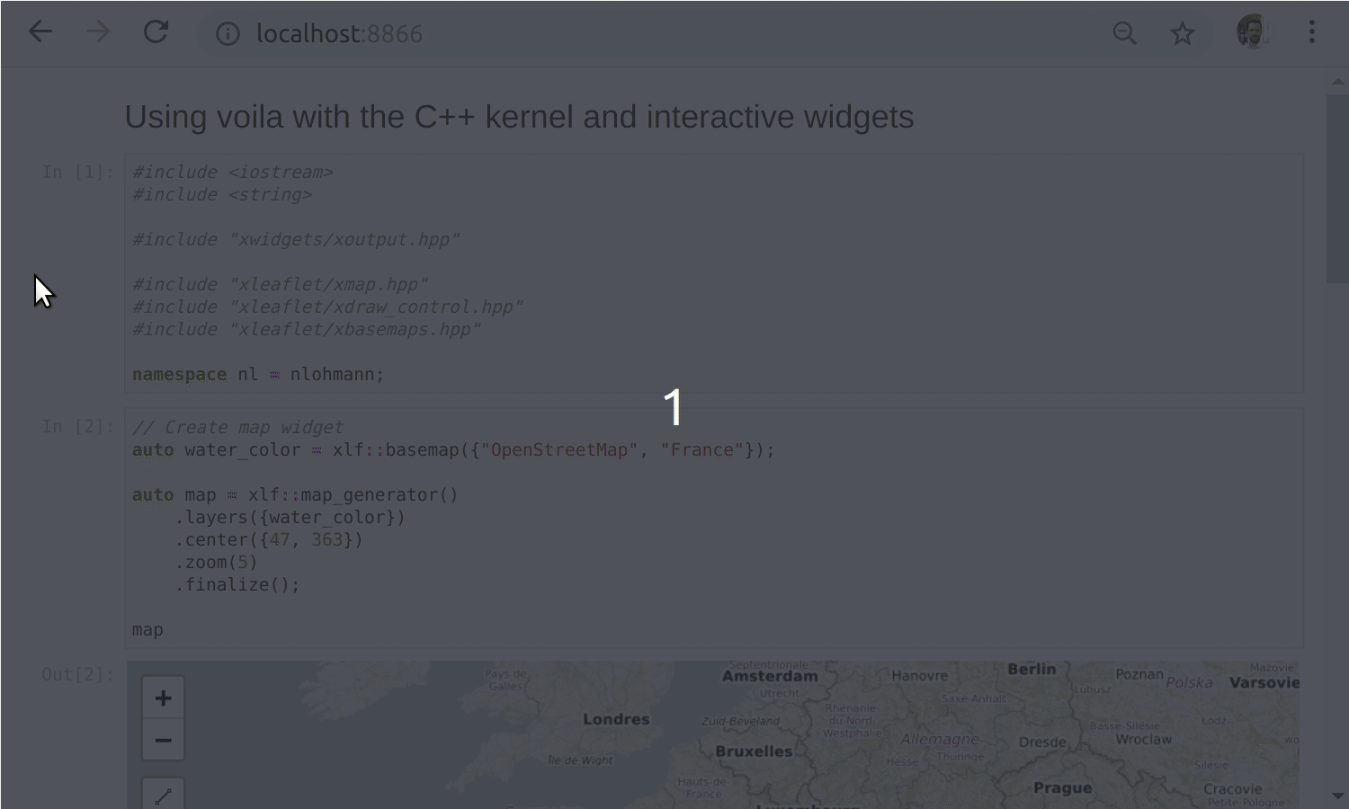
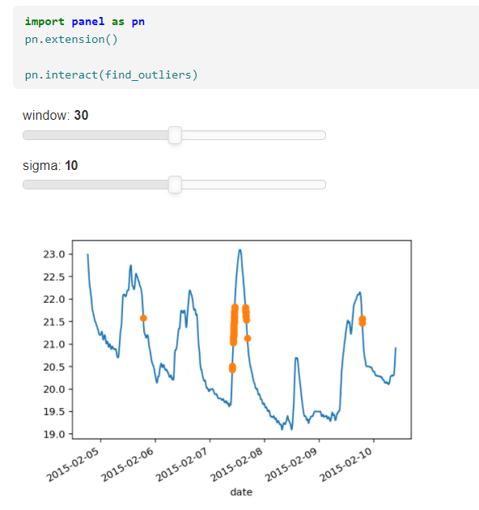
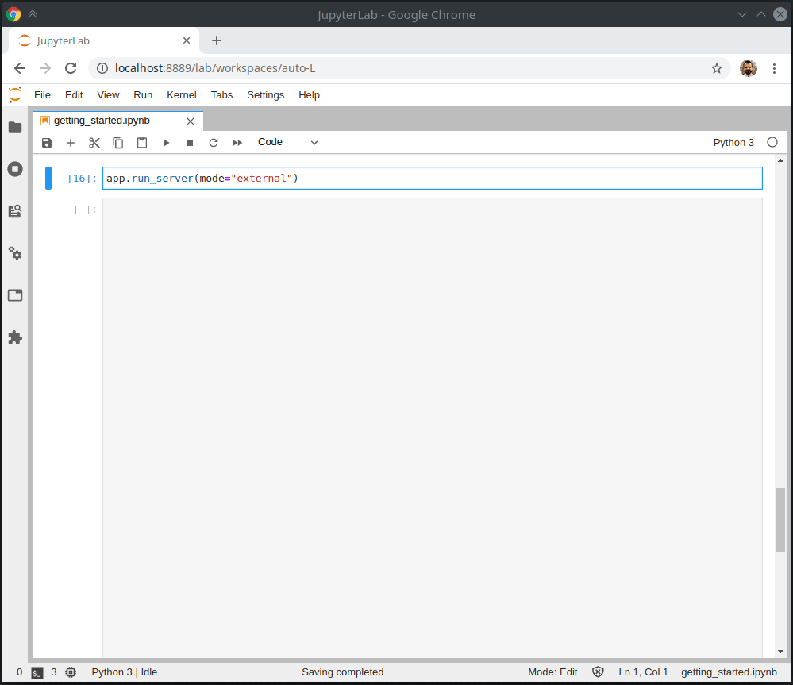
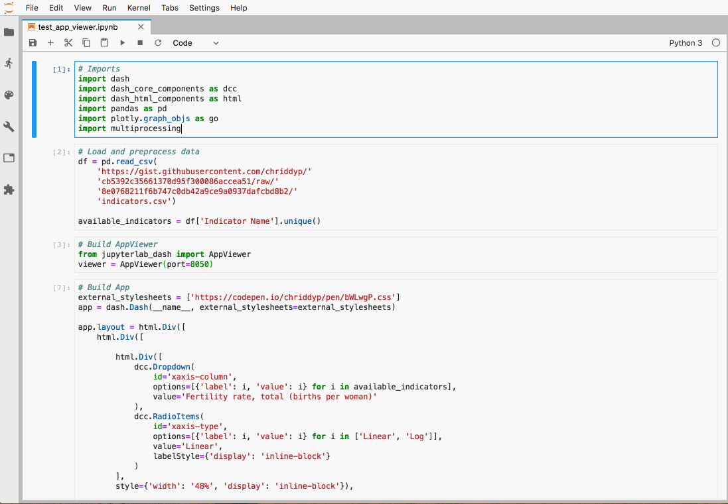
Other Popular Delivery Methods
Voila
Panel
Dash
Streamlit
Notes:
Do not spend to much time here. Go through this very quickly introduce the other libraries. Mention that these ones will require a more complex environment set up as well as code in order to work. These are more for regular reporting rather than Ad Hoc.
I didn’t choose this be

Slide 10




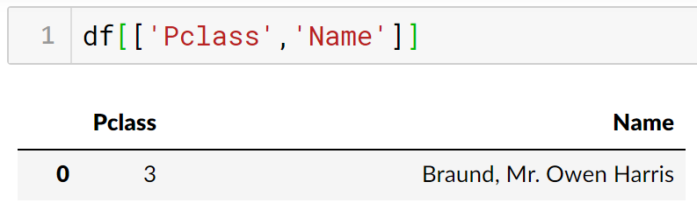
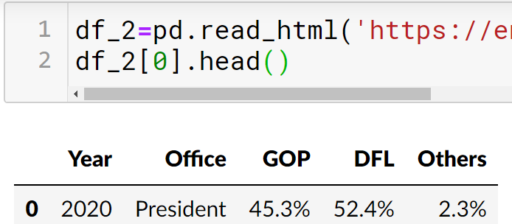
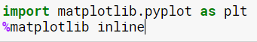
Pandas Library
Data Manipulation
Powerful and Flexibility
Integrated Plotting
Notes:
What is Pandas?
Pandas is a library for the Python programming language that strongly used for Data Analysis.
Powerful Pandas tools?
Manipulation
Dataframes
Indexing
Pivoting
Getting Data in/out
More…
Flexibility
Multiple sources
More rows than excel without getting stuck
Group by
joins
merge
concat
Emphasize that matplotlib works together with Pandas for plotting.

Slide 11
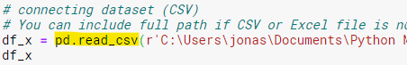
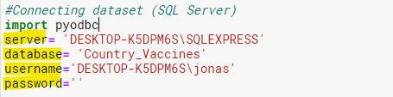
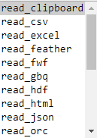
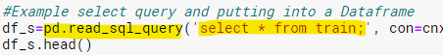
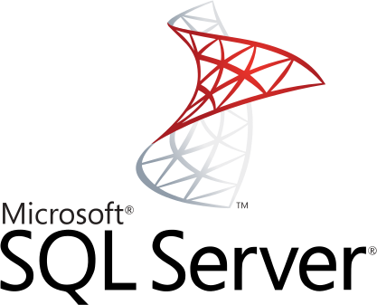
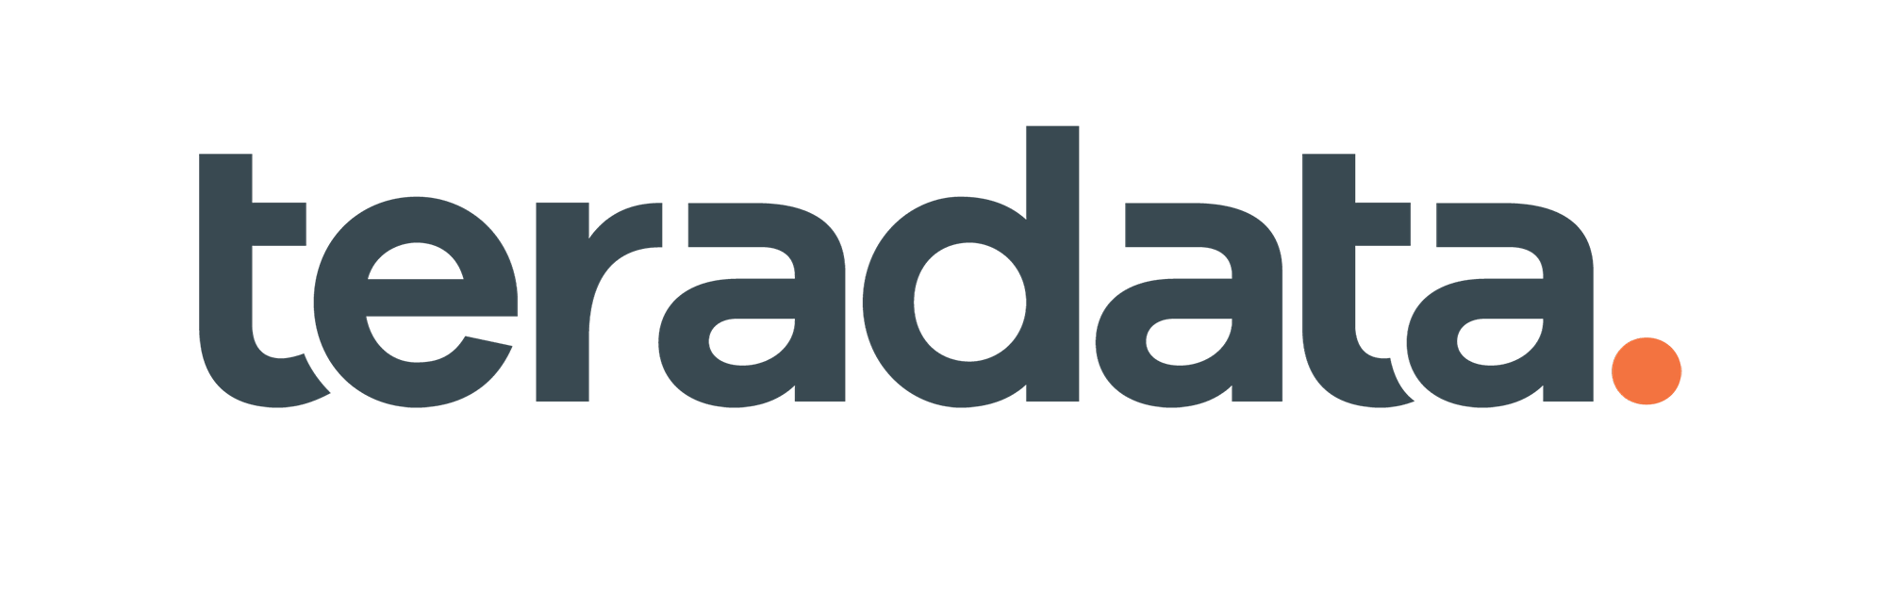


Connecting to Sources
Pandas
PyODBC
Notes:
Set up environment
Pandas
Excel/CSV
HTML
JSON
SQL…
PYODBC
SQL Server
MySQL
Oracle
Teradata
And more…
Google BigQuery
Hive from Ubuntu / Debian
Microsoft Access
Microsoft Excel
Microsoft SQL Server from Windows
Microsoft SQL Server from Linux
Microsoft SQL Server from Red Hat or CentOS
Microsoft SQL Server from Red Hat 6 or CentOS-7
Microsoft SQL Server from Mac OSX
MySQL
Netezza
Oracle from Red Hat or CentOS
PostgreSQL
SQLite
Teradata
Vertica
Emphasize the easiness to connect. Do not focus on the code but on the extensibility and great capabilities to connect to multiple sources

Slide 12
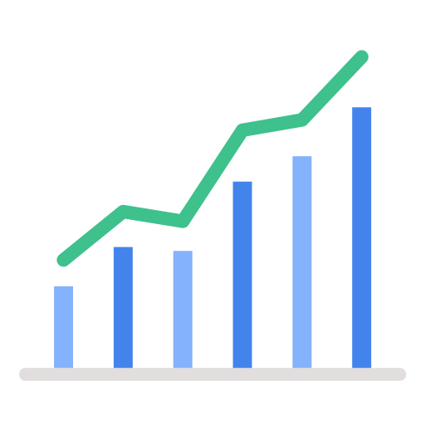
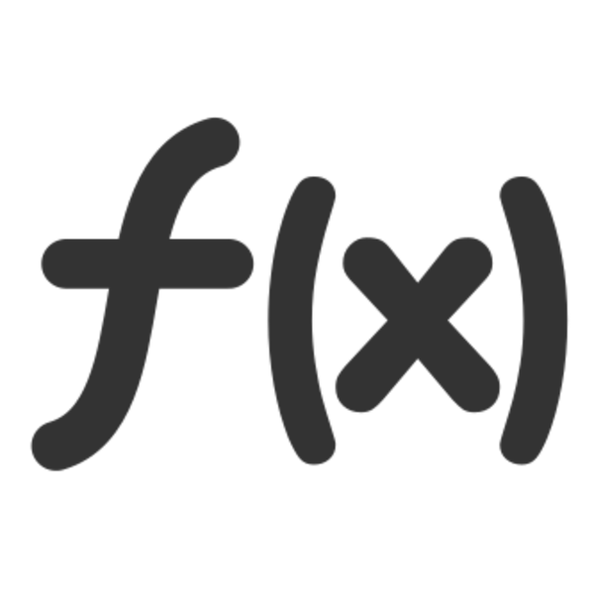


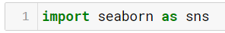
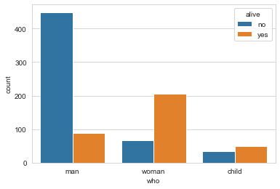
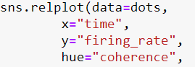
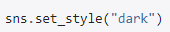
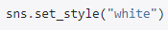
Seaborn Library
Statistical Graphics
Plotting Functions
Customization
Integration
Notes:
What is Seaborn?
Seaborn is a library for the Python programming language that allows to depict meaningful and informative statistical visualizations in a few lines of code.
Powerful Seaborn visualziations?
Themes
Drakgrid
Whitegrid
Dark
White Ticks
Visualization Types
Seaborn is a library for making statistical graphics in Python. It builds on top of matplotlib and integrates closely with pandas data structures.
Seaborn helps you explore and understand your data. Its plotting functions operate on dataframes and arrays containing whole datasets and internally perform the necessary semantic mapping and statistical aggregation to produce informative plots. Its dataset-oriented, declarative API lets you focus on what the different elements of your plots mean, rather than on the details of how to draw them.
Always keep mentioning the easiness to do so.
Showing that is a pandas dataframe is passed through seaborn to EASILY do any visualization. It takes care of the naming.
passing

Slide 13
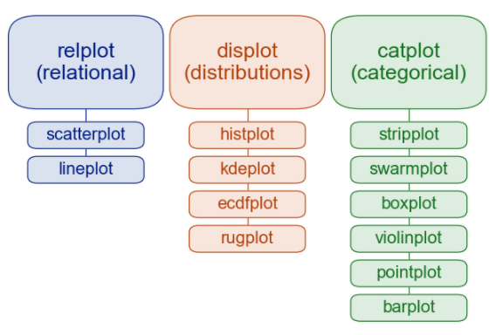
Some Seaborn Plotting Options
Notes:
The are not the only options there are. Explain how business scenarios can fit each type of plotting. Keep business meaning always upfront.

Slide 14
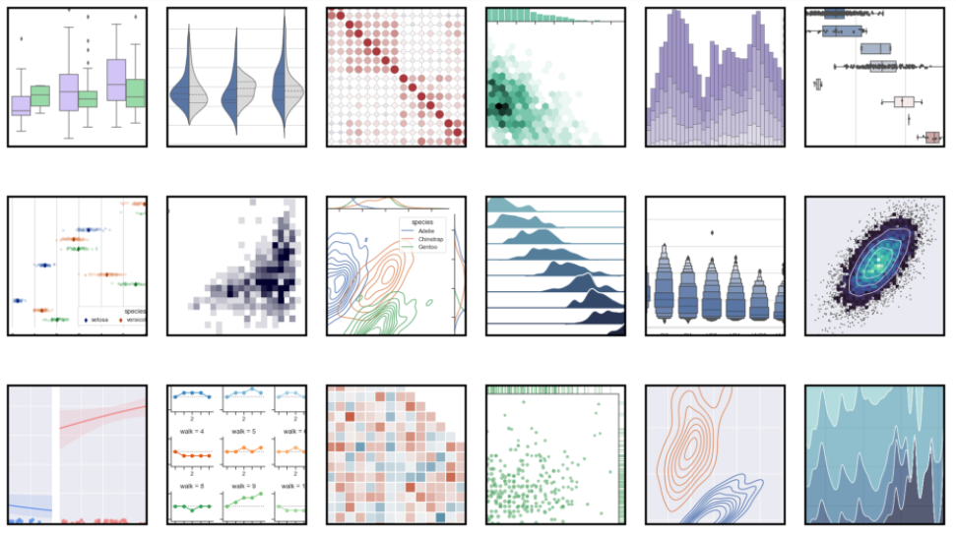
Seaborn Sample Gallery
Notes:
Go through at least 4 of them and emphasize the numerous type of plots

Slide 15

Setting Up The Environment

Slide 16
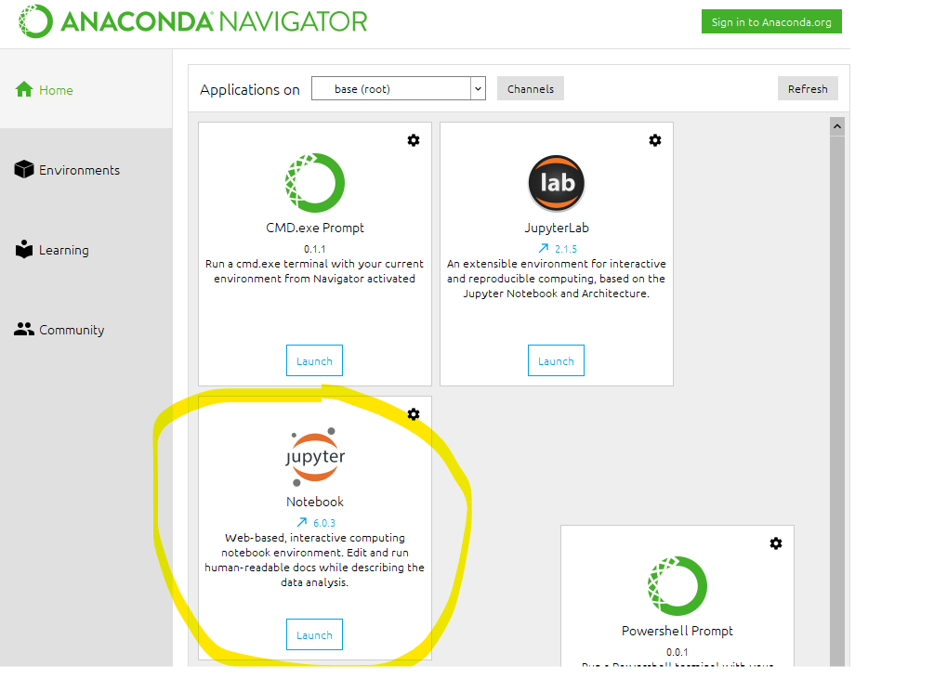
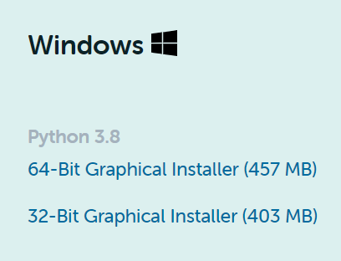
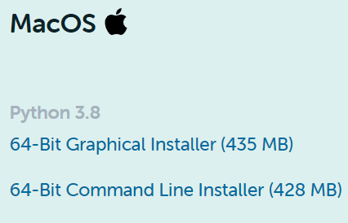
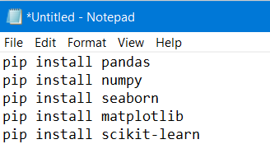
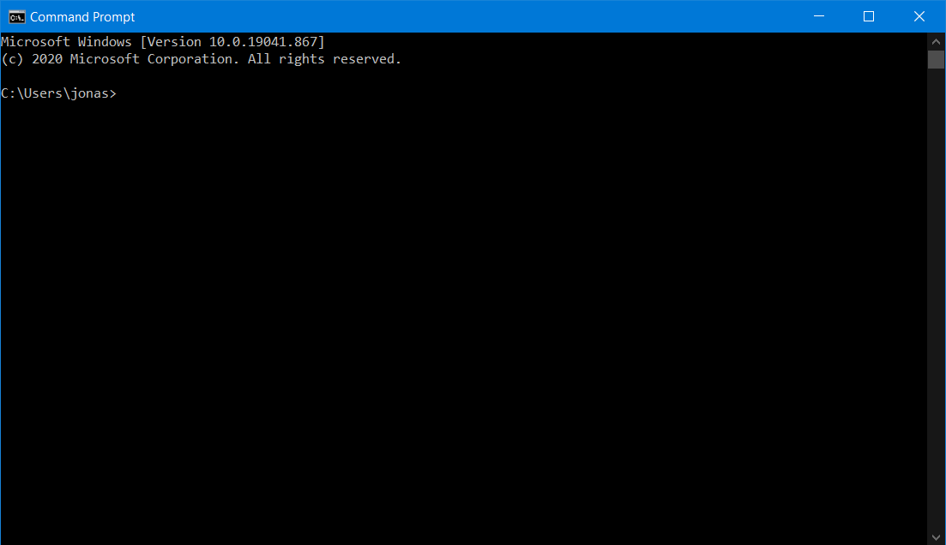


How to Install The Basic Environment
Install Anaconda IDE
Install Libraries
Open Anaconda & Use Jupyter Notebook
Notes:
Show to the audience quickly the website and how to open anaconda, open JPNB, and CMD for installing packages. This is an easy piece.

Slide 17
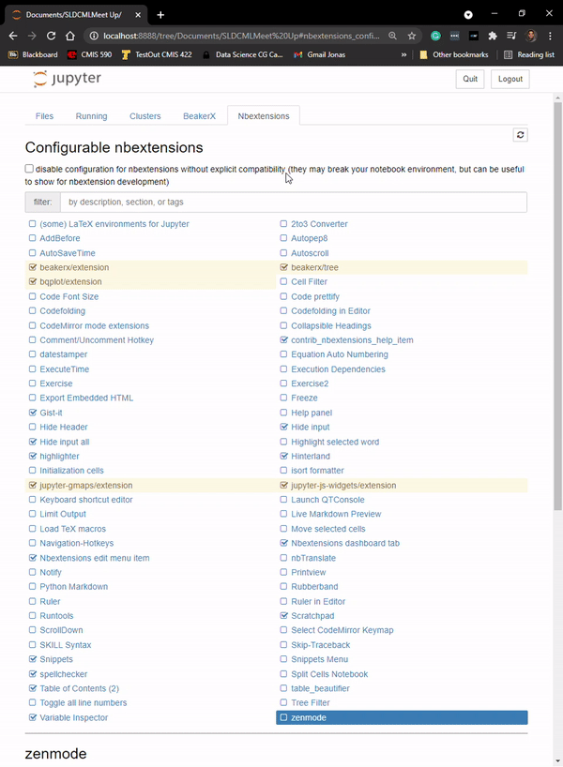
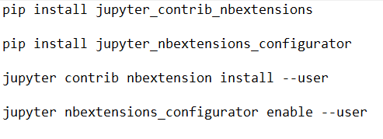
Jupyter Notebook NB Extensions
Simple Installation
Useful Extensions
Notes:
Yes, keep the easiness of JPNB upfront. Very practical to install NB extensions. Emphasize that on the demo I will show some of the extensions that are useful.
Relate this to reporting that will give us ability to hide inputs for reporting purposes. This the what is breaking the barrier. They could easily do the reporting.
“RELATE TO REPORTING”

Slide 18

Walkthrough with Pandas and Seaborn

Slide 19
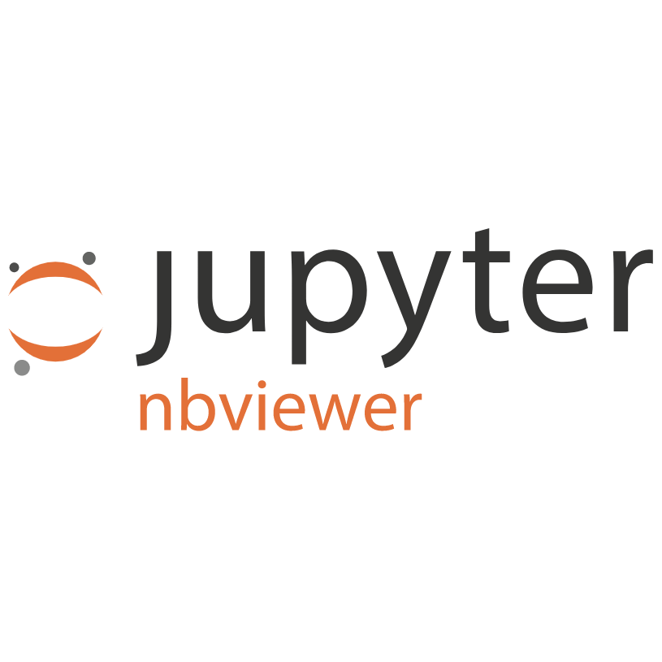


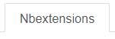
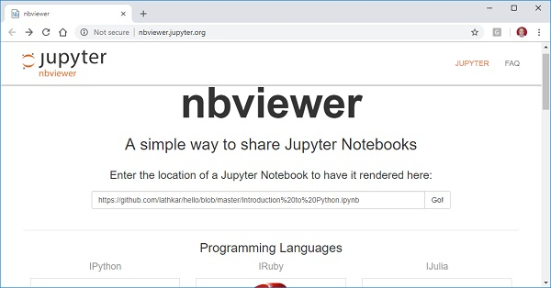
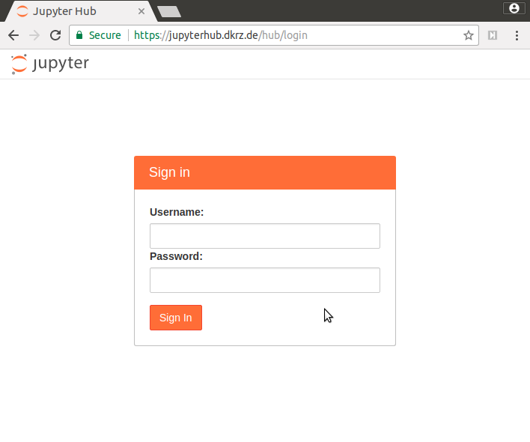
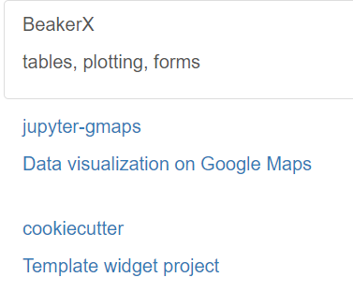
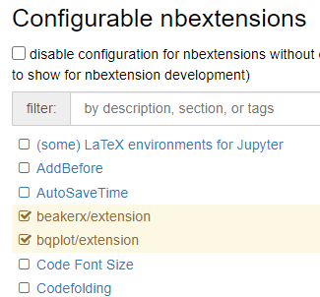
More from Jupyter Environment
NBViewer
Jupyter Hub
Widgets
NB Extensions
Notes:
Central features and tools
NBViewer
Say what is it and how useful it can be
JupyterHub
Say what is it and how useful it can be
Widgets
Name some of the widgets and how useful they are
Extensions (NB extension)
Talk about the central features of the NB Extension.
Mention NB Binder
Do not hurry on this one. Breath in and out. Talk about every feature slowly but focus on NB Extension. That is what we will use.

Slide 20
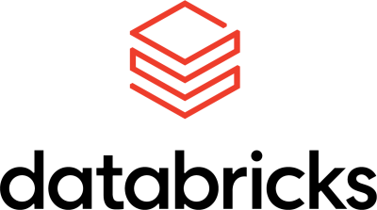


Leveraged by The Data Community
Notes:
Leverage by the Data community. Jupyter Notebooks can work in multiple environments and can be used for this kind of ad hoc reporting.

Slide 21





Conclusion
Fits Specific Use Cases
Easiness to Resolve Complex Data Limitations
Enabling Deeper Exploratory Insights
Providing for Ad Hoc Reporting Requests
More Meaningful Business Analysis
Notes:
Show this after demo. And do not forget read post-it on the monitor.
The whole point of using JPNB as an accelerator tool for Ad Hoc reporting is for giving easier, better, and more efficient business answers. Refer back Anthonys example and mention that holistic approaches to resolve business problems will bring holist results. Meaning that, the business can see the problem/solution from different angles than they are used to leading to better decision making and understanding of the business data.

Slide 22

Thank for Your Time
Notes:
If they don’t ask question bring something up. May be showing medium/data science website with more interactive reporting.

Slide 23
References
Jupyter Notebook
https://jupyter-notebook-beginner-guide.readthedocs.io/en/latest/what_is_jupyter.html
https://jupyter.org/index.html
https://jupyter.org/documentation
https://www.anaconda.com/about-us
https://jupyter.org/install
Connecting Sources
https://pypi.org/project/pyodbc/
https://github.com/mkleehammer/pyodbc/wiki
Pandas
https://pandas.pydata.org/
https://pandas.pydata.org/docs/
Seaborn
https://seaborn.pydata.org/index.html
https://seaborn.pydata.org/examples/index.html#
Other Popular Delivery Methods
https://blog.jupyter.org/and-voil%C3%A0-f6a2c08a4a93
https://panel.holoviz.org/
https://medium.com/plotly/introducing-jupyterdash-811f1f57c02e
https://discuss.streamlit.io/
How to install The Basic Environment
https://www.youtube.com/watch?v=kbTSj5xTgNc
https://www.anaconda.com/products/individual
https://www.youtube.com/watch?v=vG4AHYXsOgc
Extensions
https://www.kdnuggets.com/2019/06/jupyter-notebooks-data-science-reporting.html
Notes:
Make this available for others. This could be helpful for the other folks that are unexperienced.

